Slide 1
human rights violations committed by the Wagner Group and host nations
Fidel Nkwocha

Slide 2
AGENDA
Introduction
Primary goals
Methods
Timeline
Summary

Slide 3
About the wagner group
Private Military Contractor
Involved in conflicts in several countries
Claims to professionalize militaries in order to shorten conflicts
But extends conflicts for selfish gains

Slide 4
PRIMARY GOALS
Gather information on Wagner Group’s:
Human Rights Violations
Presence around the World
Host Nations enabling them

Slide 5
methods
Research paper reporting human rights violations by Wagner Group and Host Nations
Bing News API
Search for any mention of Wagner Group from Python code
Web
Search the web using the Google search engine
Tracking
Generated a dataset based on data from articles returned by the Bing News API articles and the Google search engine
Created a treemap showing Wagner Group’s presence around the World
Output
Visualization

Slide 6
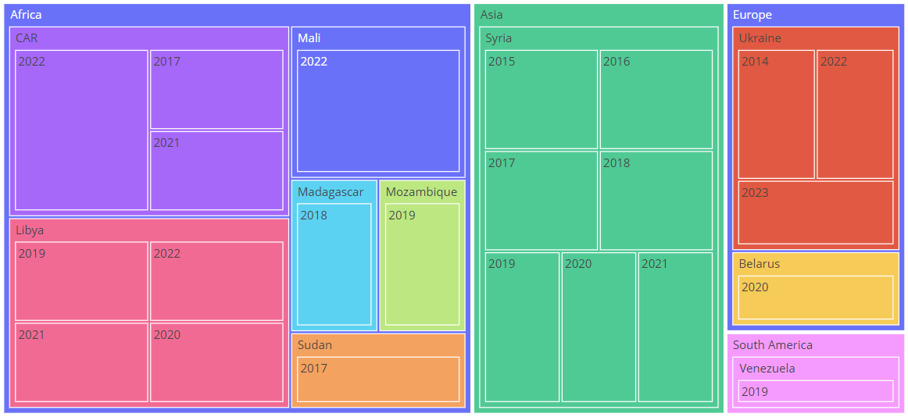
Timeline of Wagner Group’s presence

Slide 7
AREAS of improvement
More resources for organizations tracking Wagner Group
More publicly available APIs
More research projects by students

Slide 8
SUMMARY
We need significant action by international community
Sanctions alone have not worked

